Slide 1
Project: Blood Donation Finder
By Group 7
Aryan Mainalee
Deepesh Bastola
Sulav Tiwari
Under Supervision of
Sanju Shrestha

Slide 2
Table of Contents
Project Overview
Problems/Challenges
Literature Review
Goals and Objectives
Features
Methodology
Feasibility
Gantt Chart
Technology Used
Comparative Study
Conclusion

Slide 3
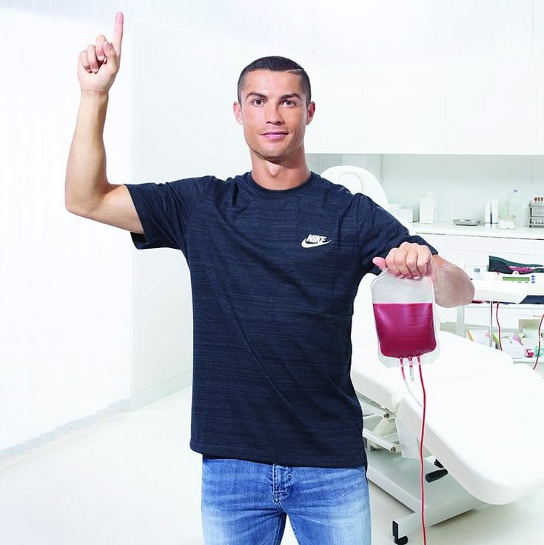
Project Overview: Blood Donation Finder
A life-saving platform designed to connect blood donors with recipients in real time during medical emergencies. It simplifies and accelerates the process of finding the right blood type nearby, ensuring timely help when every second matters.

Slide 4

PROBLEMS/CHALLENGES
Hard to find donors quickly in emergencies
No proper platform for donor connection
Delay due to manual phone searches
Outdated donor and blood records
Shortage of rare blood groups
Low awareness of blood donation
Need secure user data storage

Slide 5
Literature Review
A systematic literature review of the blood supply chain through bibliometric analysis and taxonomy, https://www.Mdpi.Com/2079-8954/11/3/124
Knowledge, attitude and practice of voluntary blood donation among higher education students in Nepal, https://nepjol.Info/index.Php/pjri/article/download/87678/66464
Impact of natural disasters and pandemics on blood supply: A systematic review, https://www.Sciencedirect.Com/science/article/pii/S2772632023000132?Via%3dihub
Blood transfusion services in Nepal: an overview, https://www.Researchgate.Net/publication/394055105_blood_transfusion_services_in_nepal_an_overview
https://bloodconnect.org/
Sankalp India Foundation's app, https://hamrolifebank.com/

Slide 6
GOAL and OBJECTIVES
Primary Goal:
Provide a fast, reliable, and user-friendly platform for emergency blood connection.
Objectives
Develop fast donor connection system
Create reliable and accurate platform
Design simple user-friendly interface
Reduce delay in finding donors
Improve communication between users
Maintain structured donor database
Ensure quick emergency response

Slide 7
FEATURES
Core Features
User & Organization Registration
Blood Request System
Donor-Requester Matching
Request Status Tracking
Secondary Features
In-App Chat
Donor Availability Toggle
Donation History
Email/SMS Notifications
Admin Dashboard

Slide 8
METHODOLOGY
Requirement analysis by identifying user needs
Designing system structure (UI wireframes and database design)
Front-end development using HTML, CSS, JS
Back-end development using Node.js, Socket.io, Express.js
Database creation to store donor and blood information(MySQL)
Testing the system for errors and functionality
Deployment of the web application for user access
Collecting feedback and improving the system

Slide 9

FEASIBILITY
Technically feasible using web technologies
Uses common stack HTML CSS JS
Backend supported by Node Express MySQL
Socket.io enables real-time communication
Email notifications improve emergency response
Low cost development and maintenance required

Slide 11
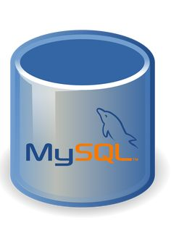

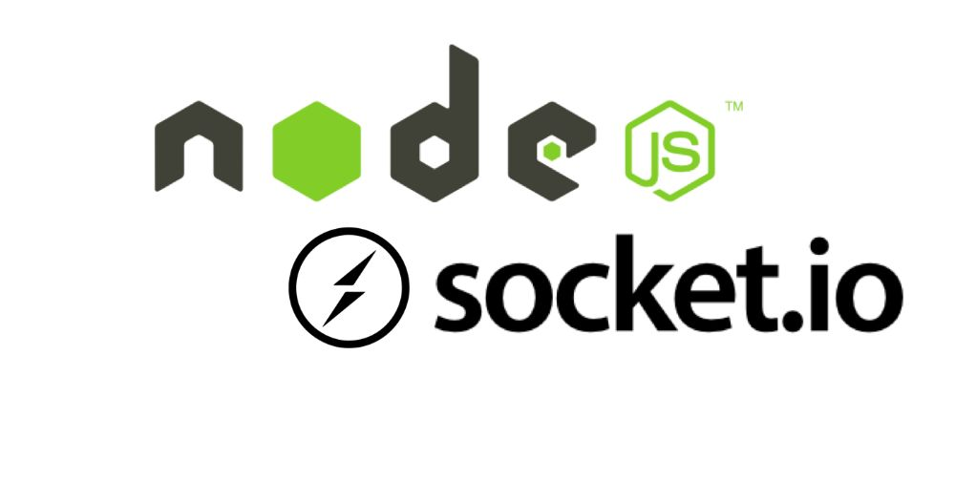
TECHNOLOGY USED
Frontend
HTML
CSS
JAVASCRIPT
Backend
NodeJS
Socket.io
Express.js
Database
MYSQL

Slide 12
COMPARATIVE STUDY
Traditional System vs Our Web App
Traditional: Phone calls / manual search
Our system: Fast online donor connection
Existing Blood Donation Apps vs Our Project
Existing apps: Limited features / slow updates
Our system: Real-time communication + email alerts

Slide 13
COMPARATIVE STUDY(CONT..)
Manual Records vs Database System
Manual: Paper-based, error-prone
Our system: Structured MySQL database
Awareness System
Traditional: Low awareness, offline campaigns
Our system: Easy digital access for everyone

Slide 14

CONCLUSION
So, this project aims to develop a fast and reliable blood donation web application to improve emergency blood access and reduce delays in critical situations. It will be developed over a 13-week timeline using compatible technologies. Overall, it provides an efficient and simple solution to improve blood availability and save lives.

Slide 15


